Slide 1
1. Install Anaconda
Be sure the install Anaconda 5.0.1 or later

Slide 2
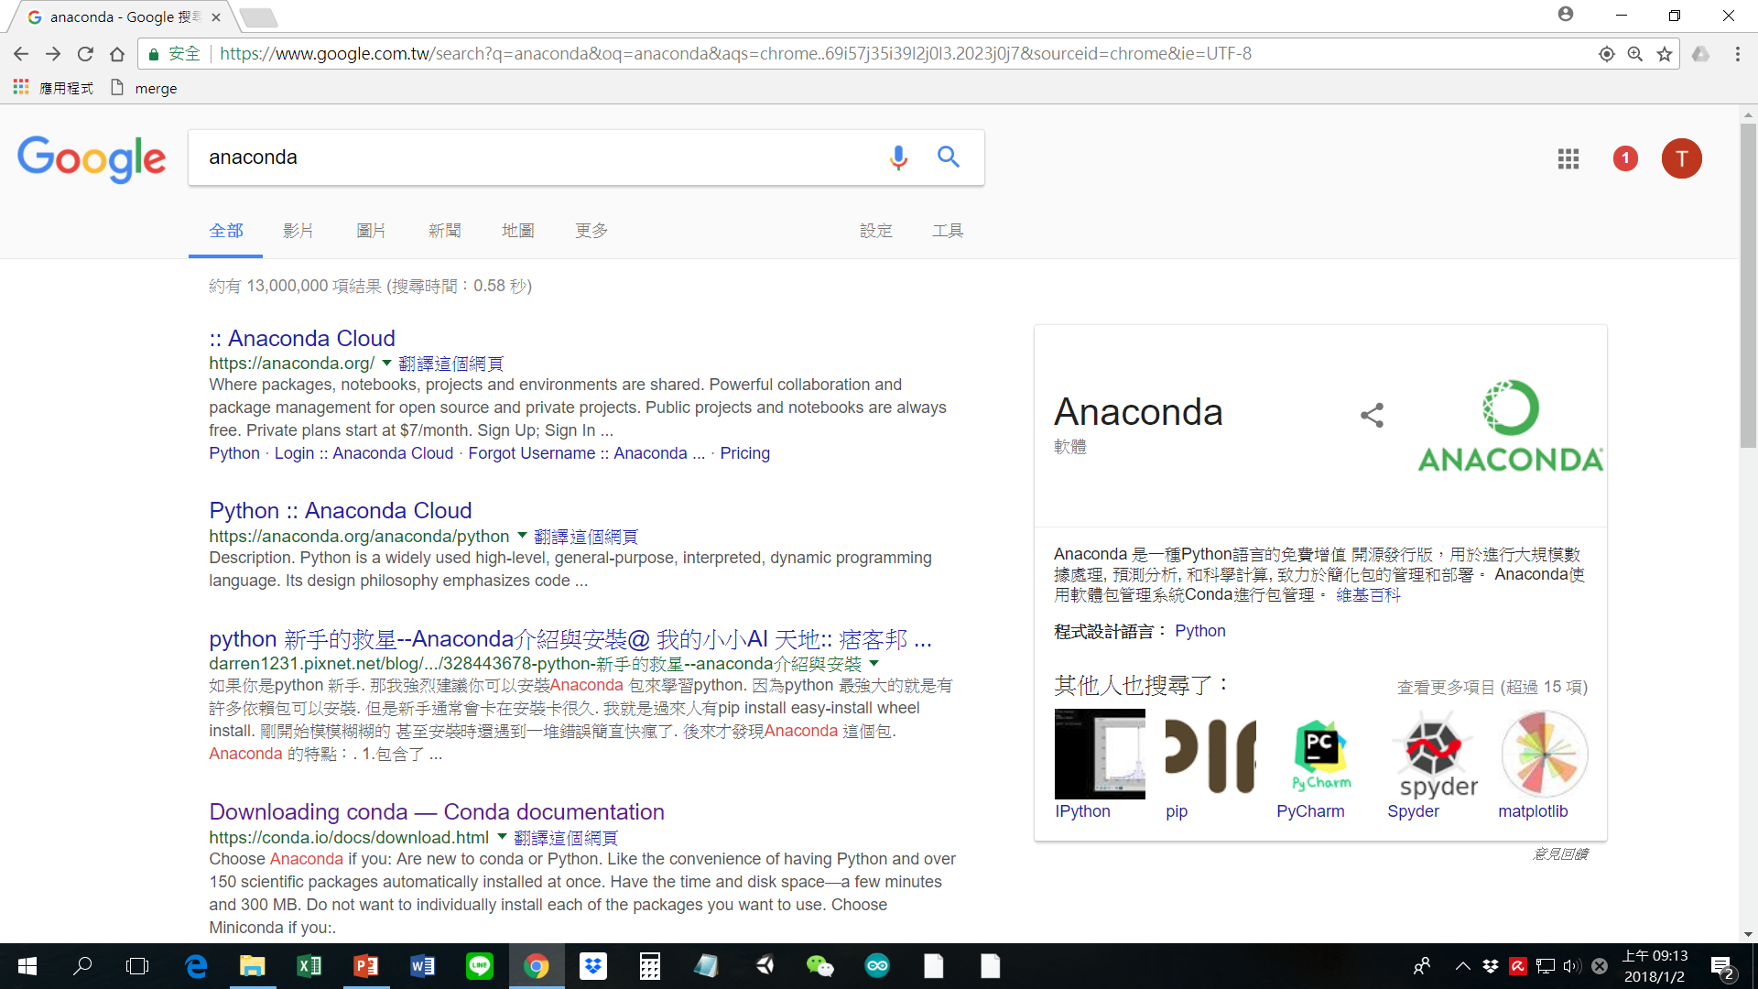

Slide 3


Slide 4
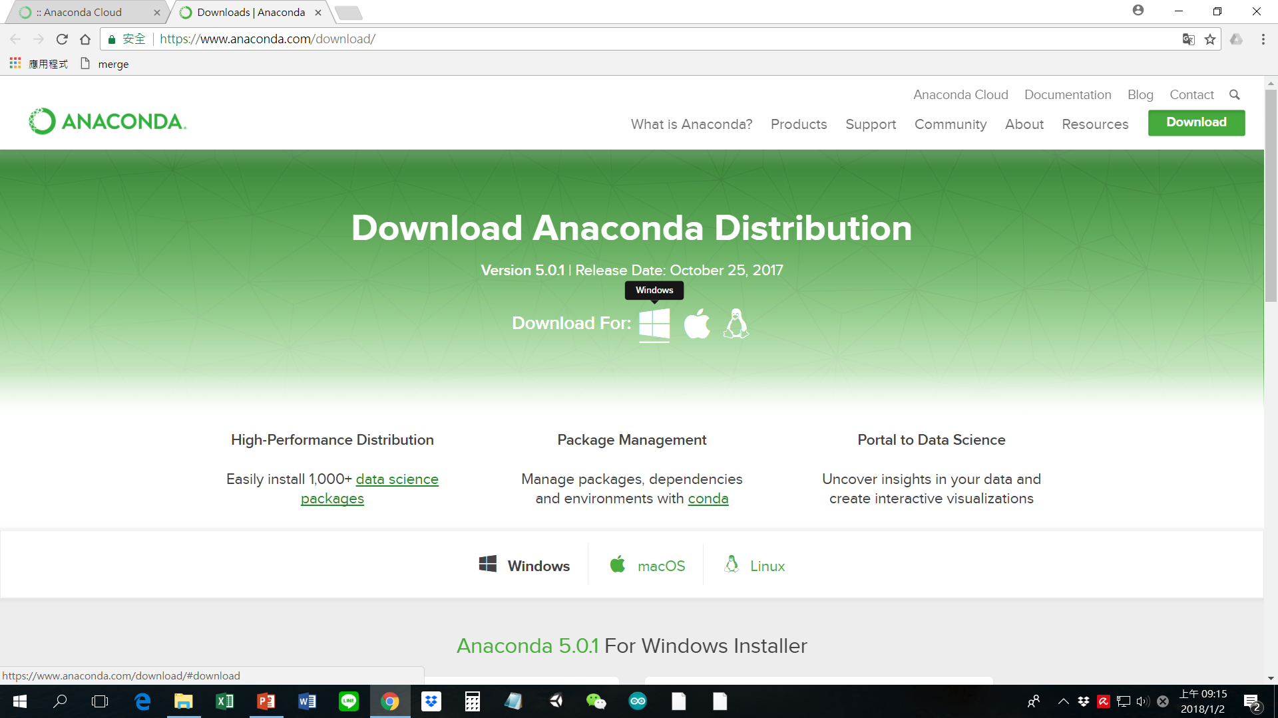

Slide 5
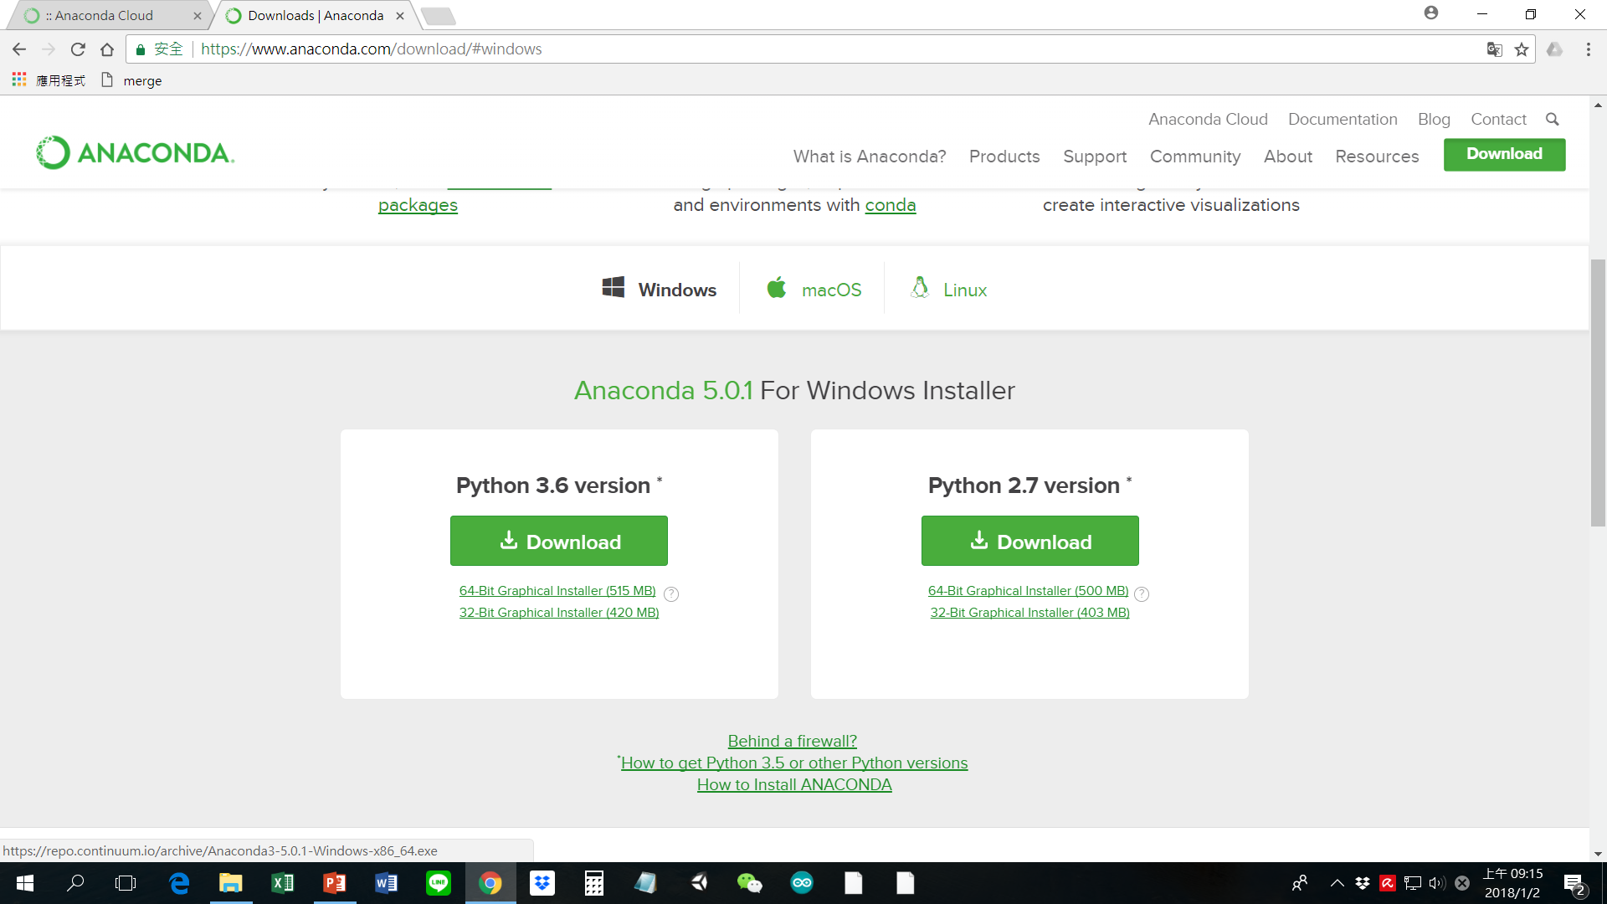

Slide 6
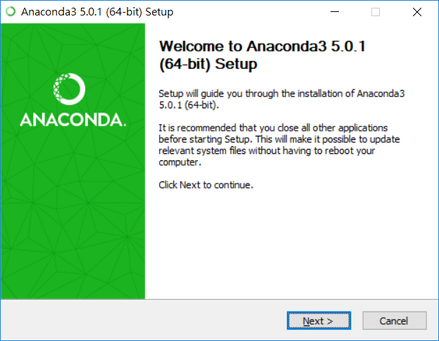
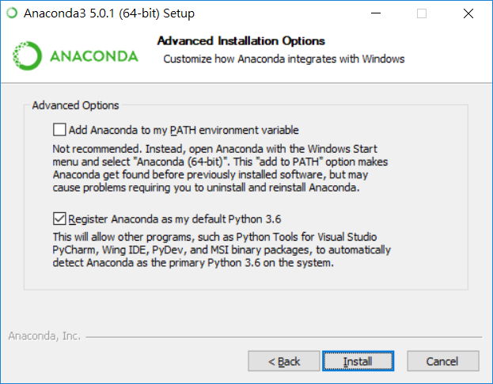

Slide 7
2. Create a virtual environment to run PyTorch

Slide 8
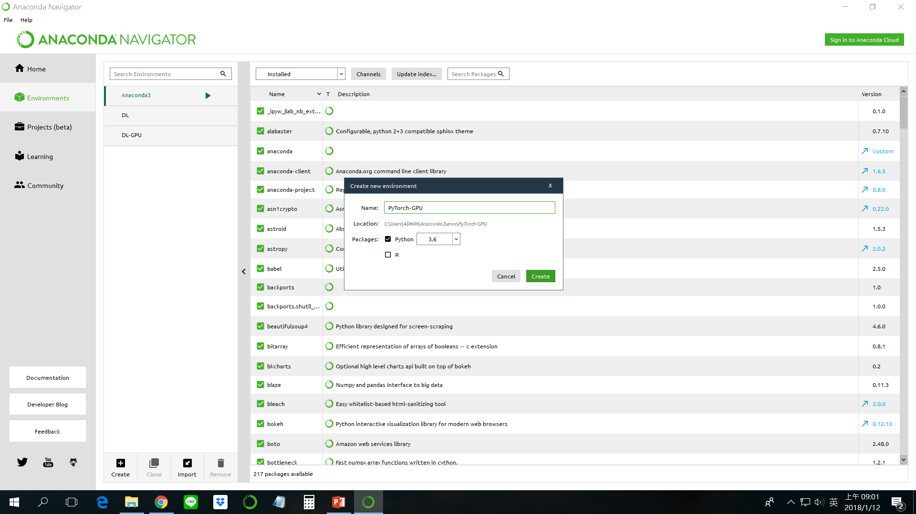
Create a Python 3.6 environment named PyTorch-GPU (you can name whatever you want)

Slide 9
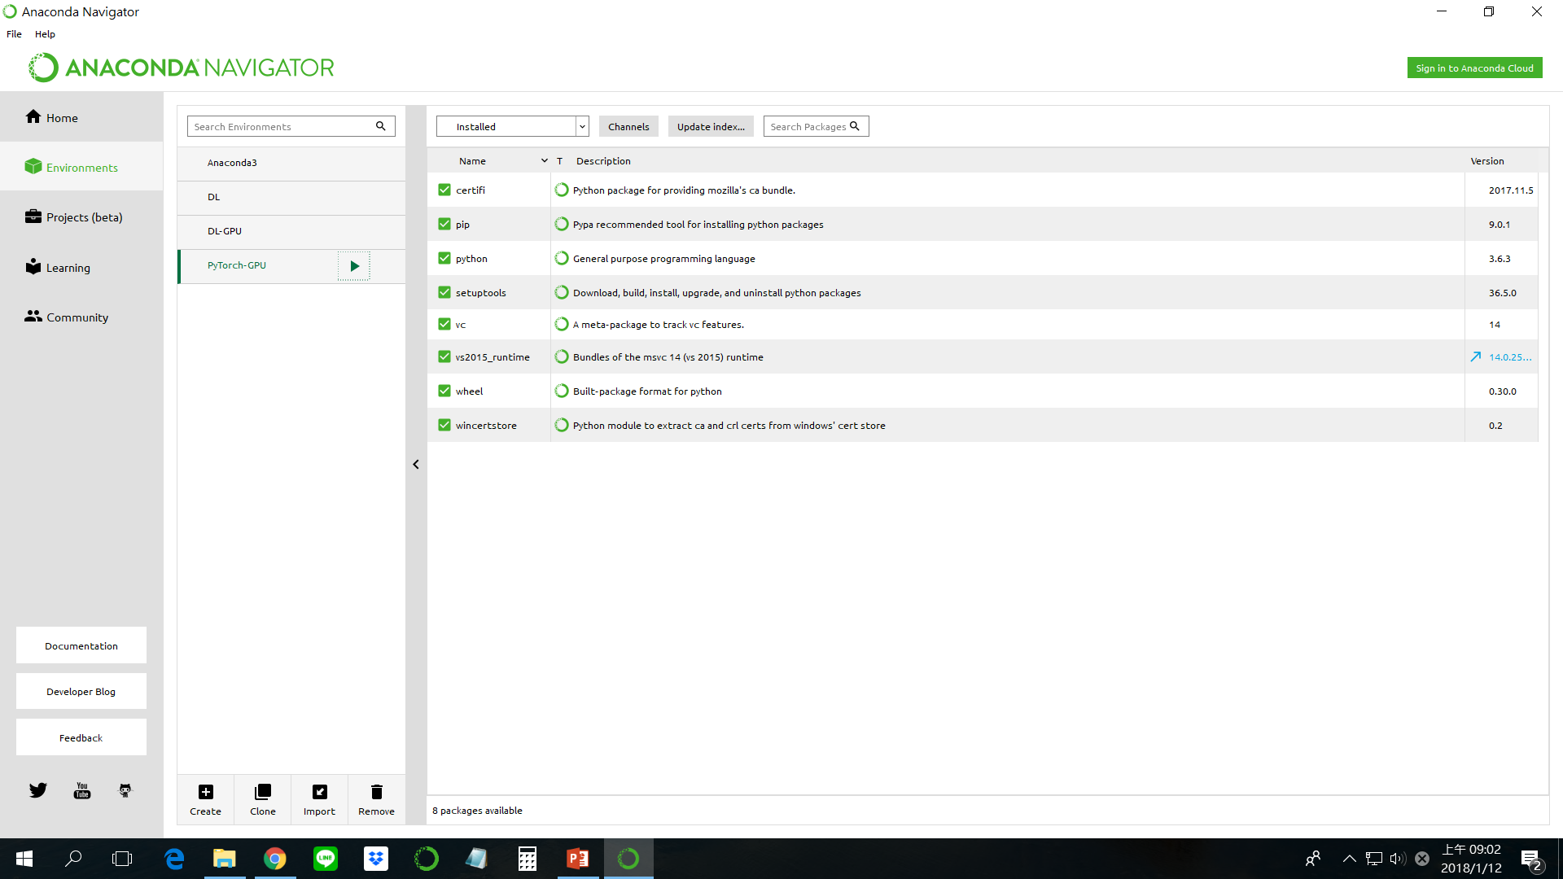
Beginning screen of my PyTorch-GPU environment

Slide 10
3. Install python libraries in the virtual environment

Slide 11
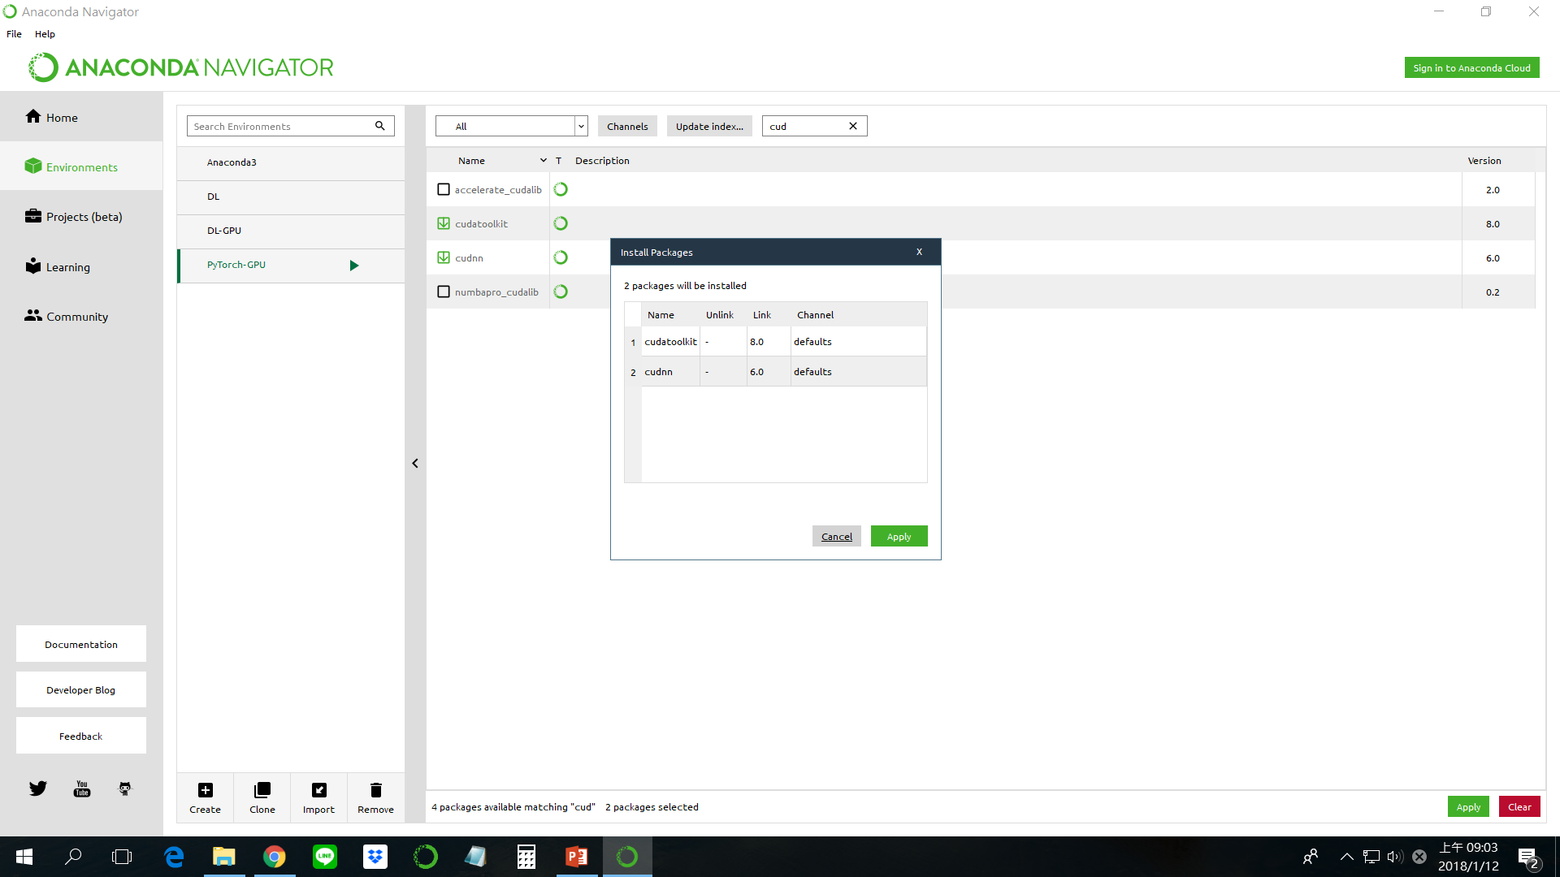
Install cuda 8.0 and cudnn 6.0

Slide 12
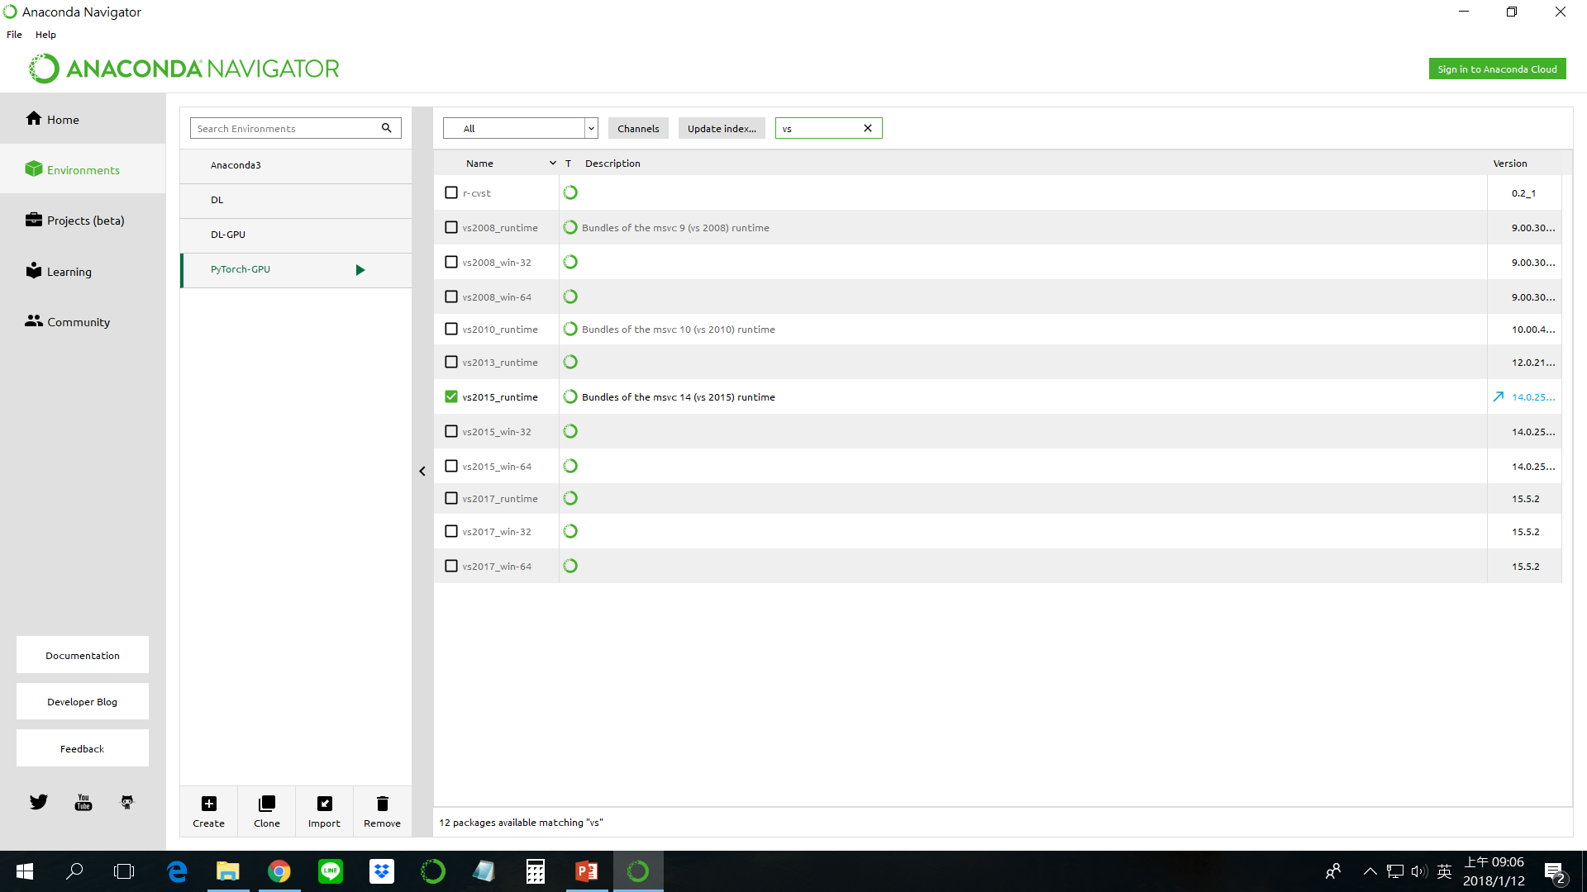
Install vs 2015

Slide 13
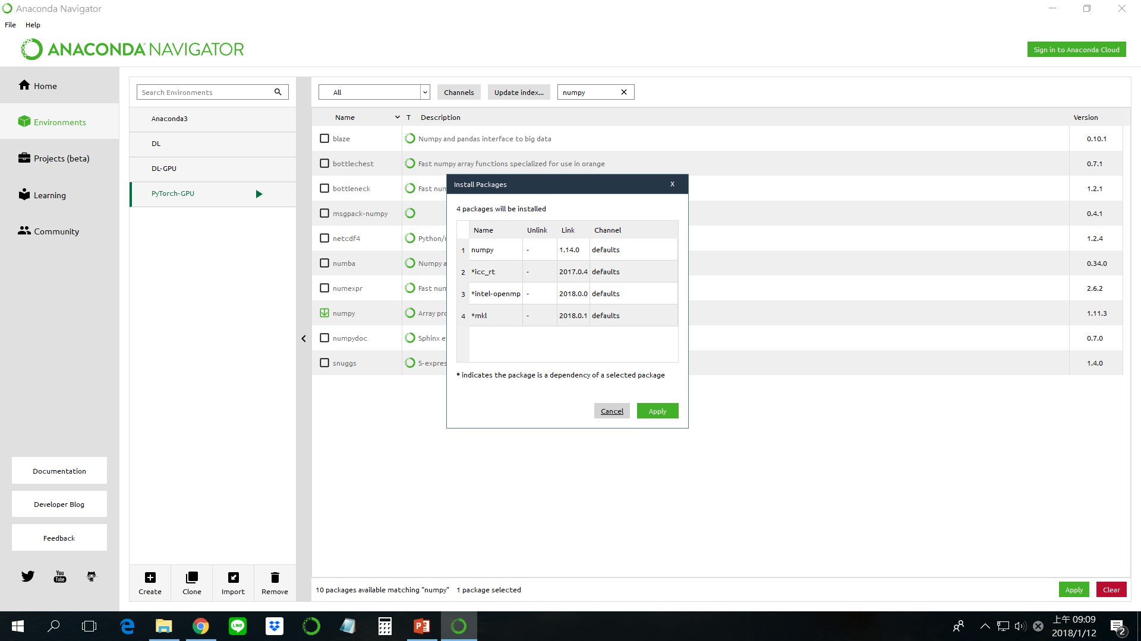
Install numpy

Slide 14
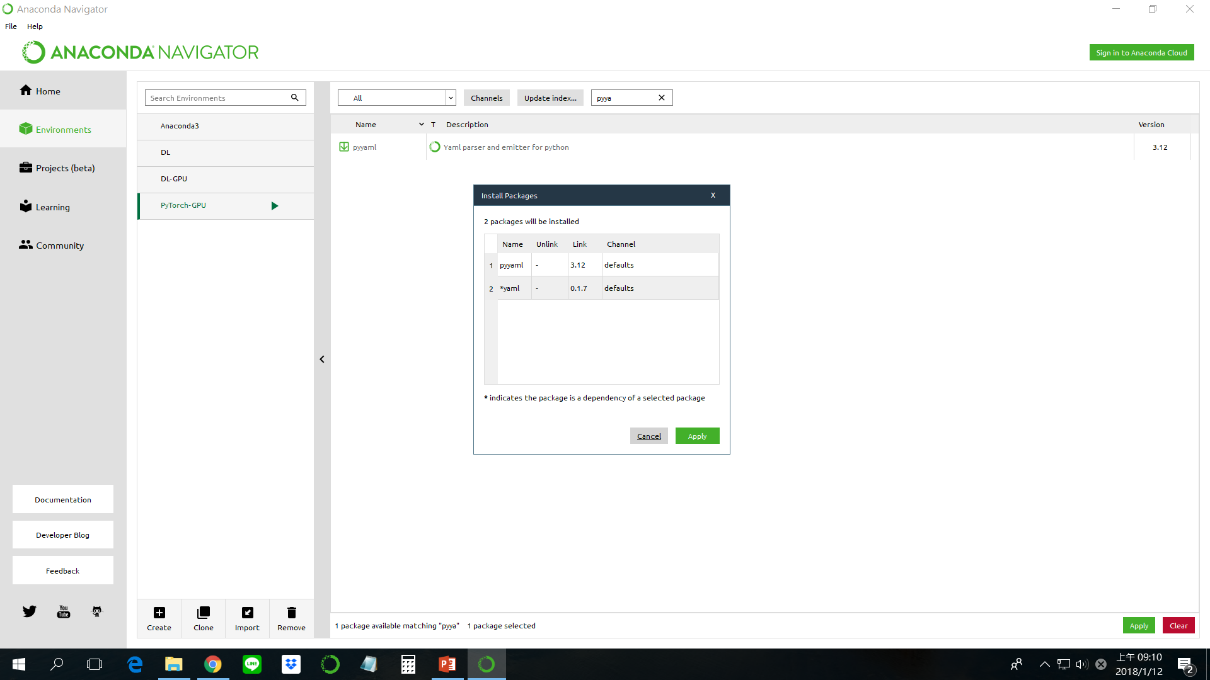
Install pyyaml

Slide 15
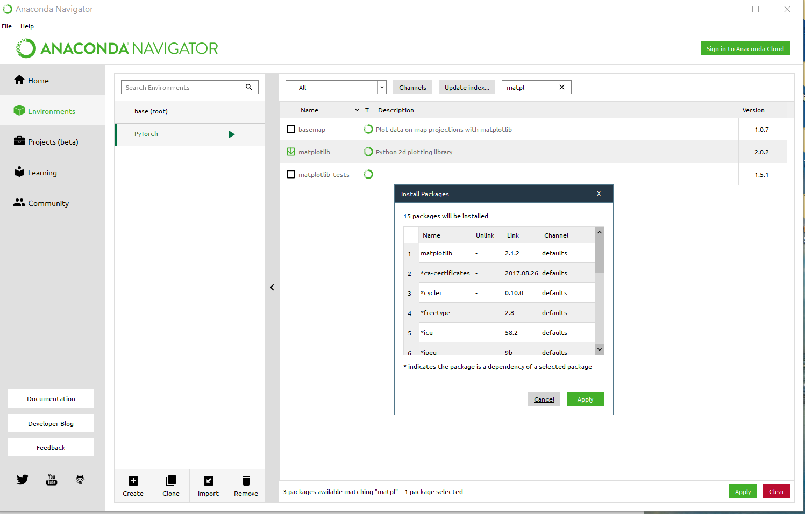
Install matplotlib – python 2d plotting library

Slide 16
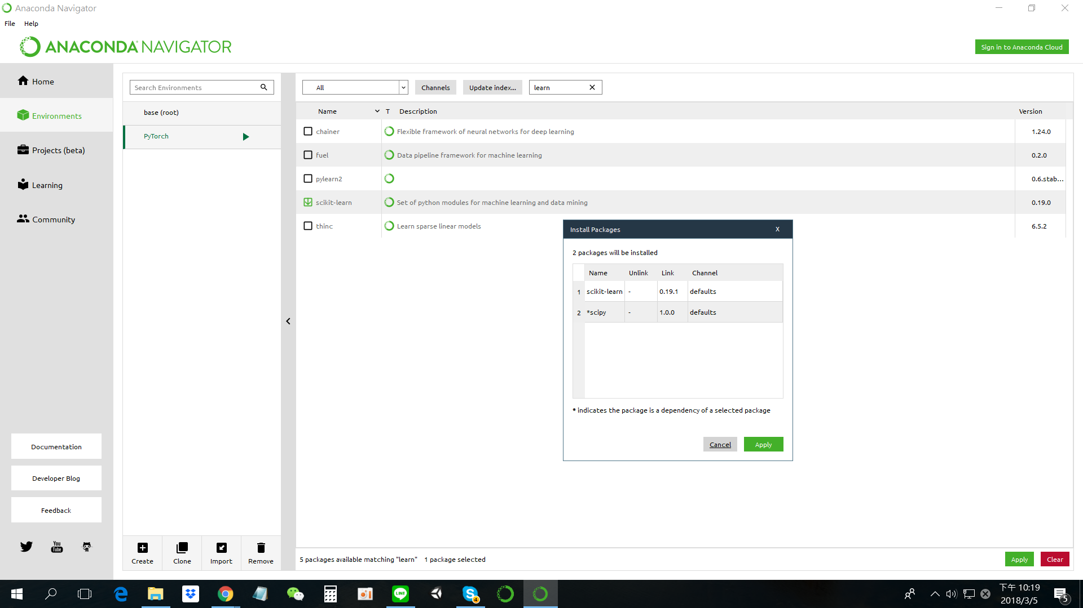
Install scikit-learn – set of python modules for machine learning and data mining

Slide 17
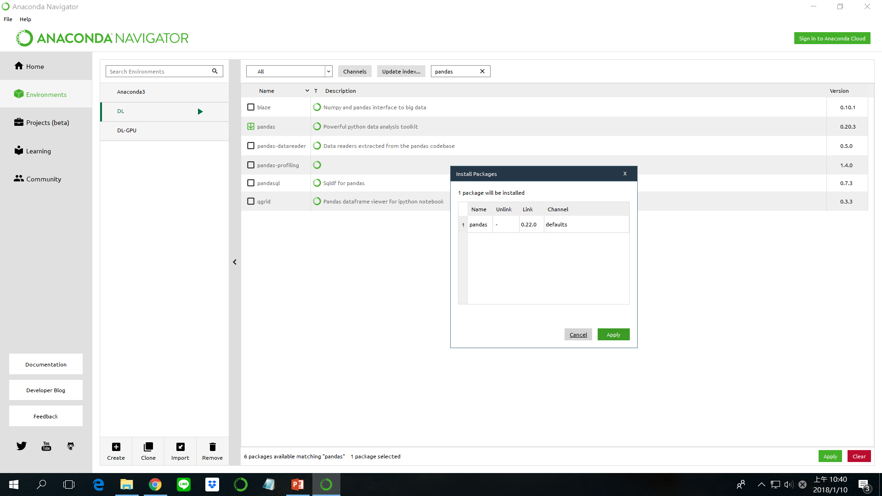
pandas – powerful python data analysis toolkit

Slide 18
OpenCV – computer vision

Slide 19
4. Install PyTorch and TorchVision libraries in this virtual environment

Slide 20
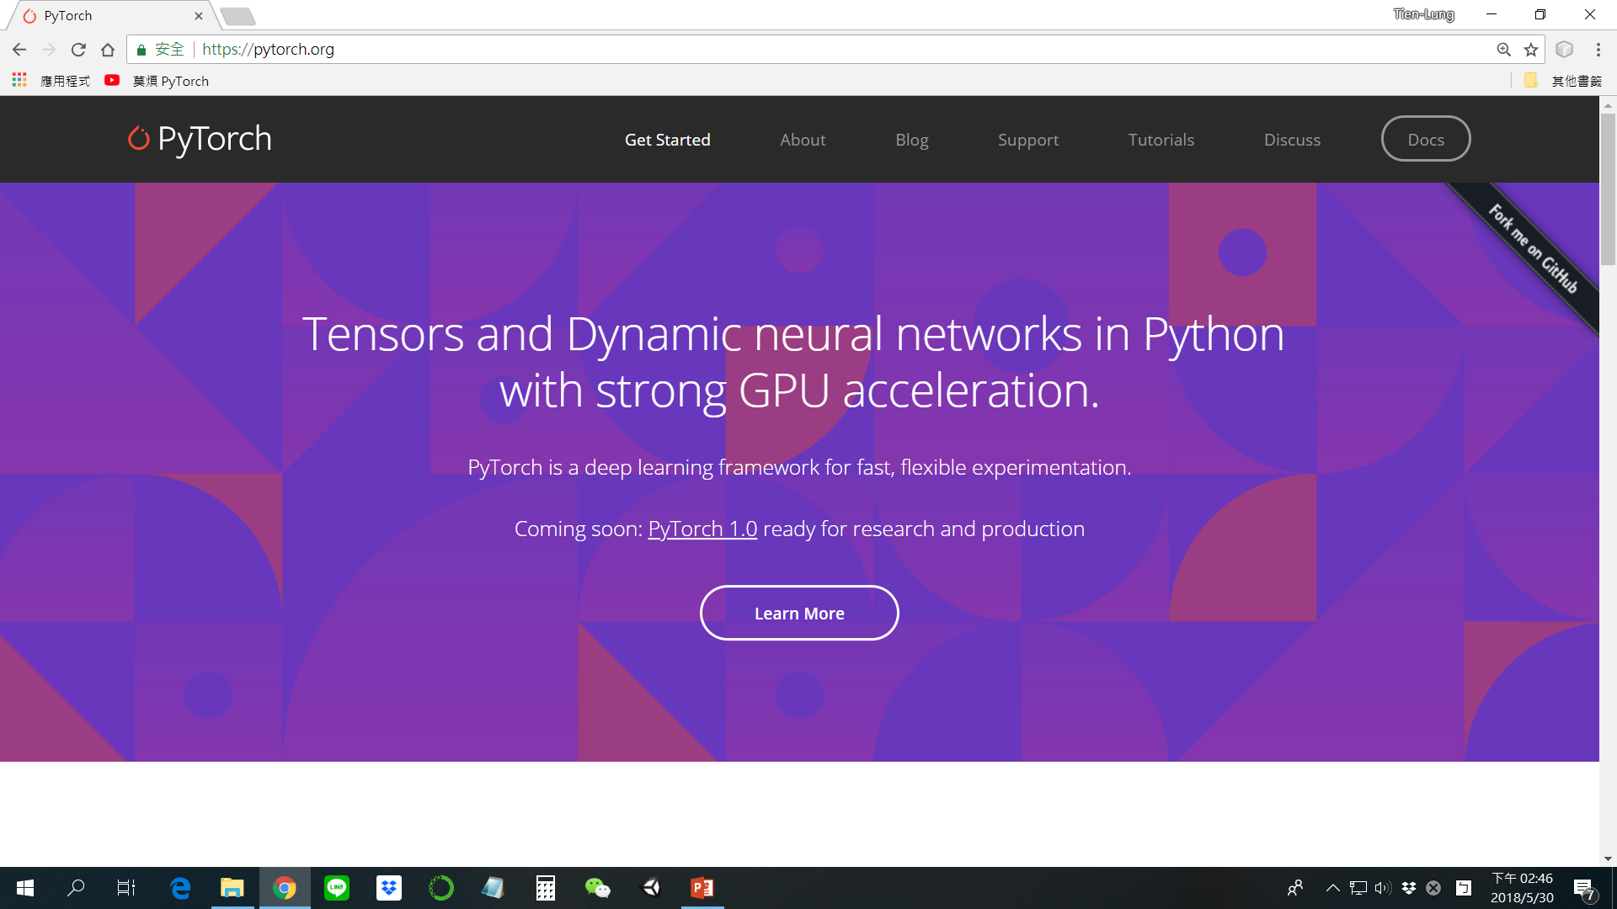
https://pytorch.org/

Slide 21
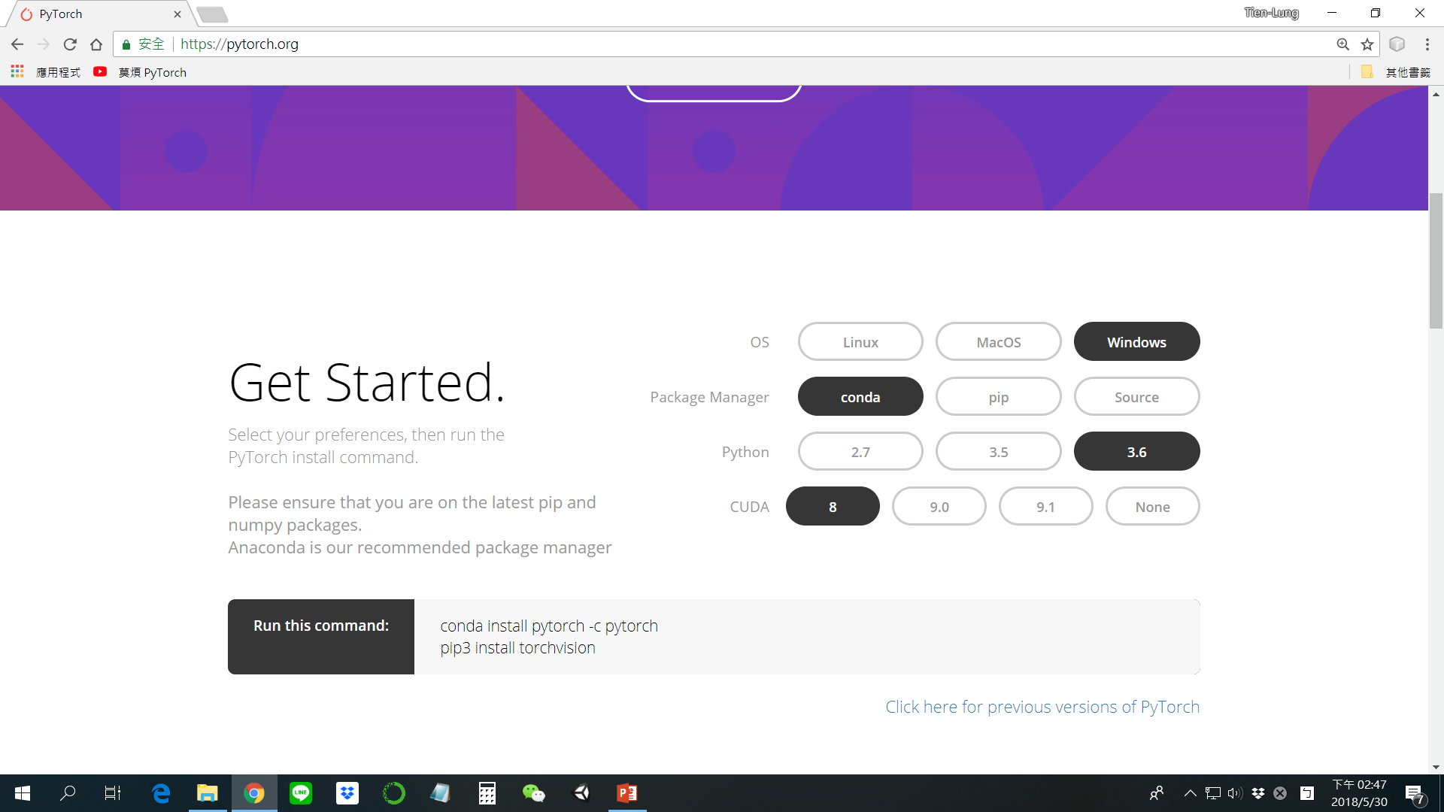

Slide 22
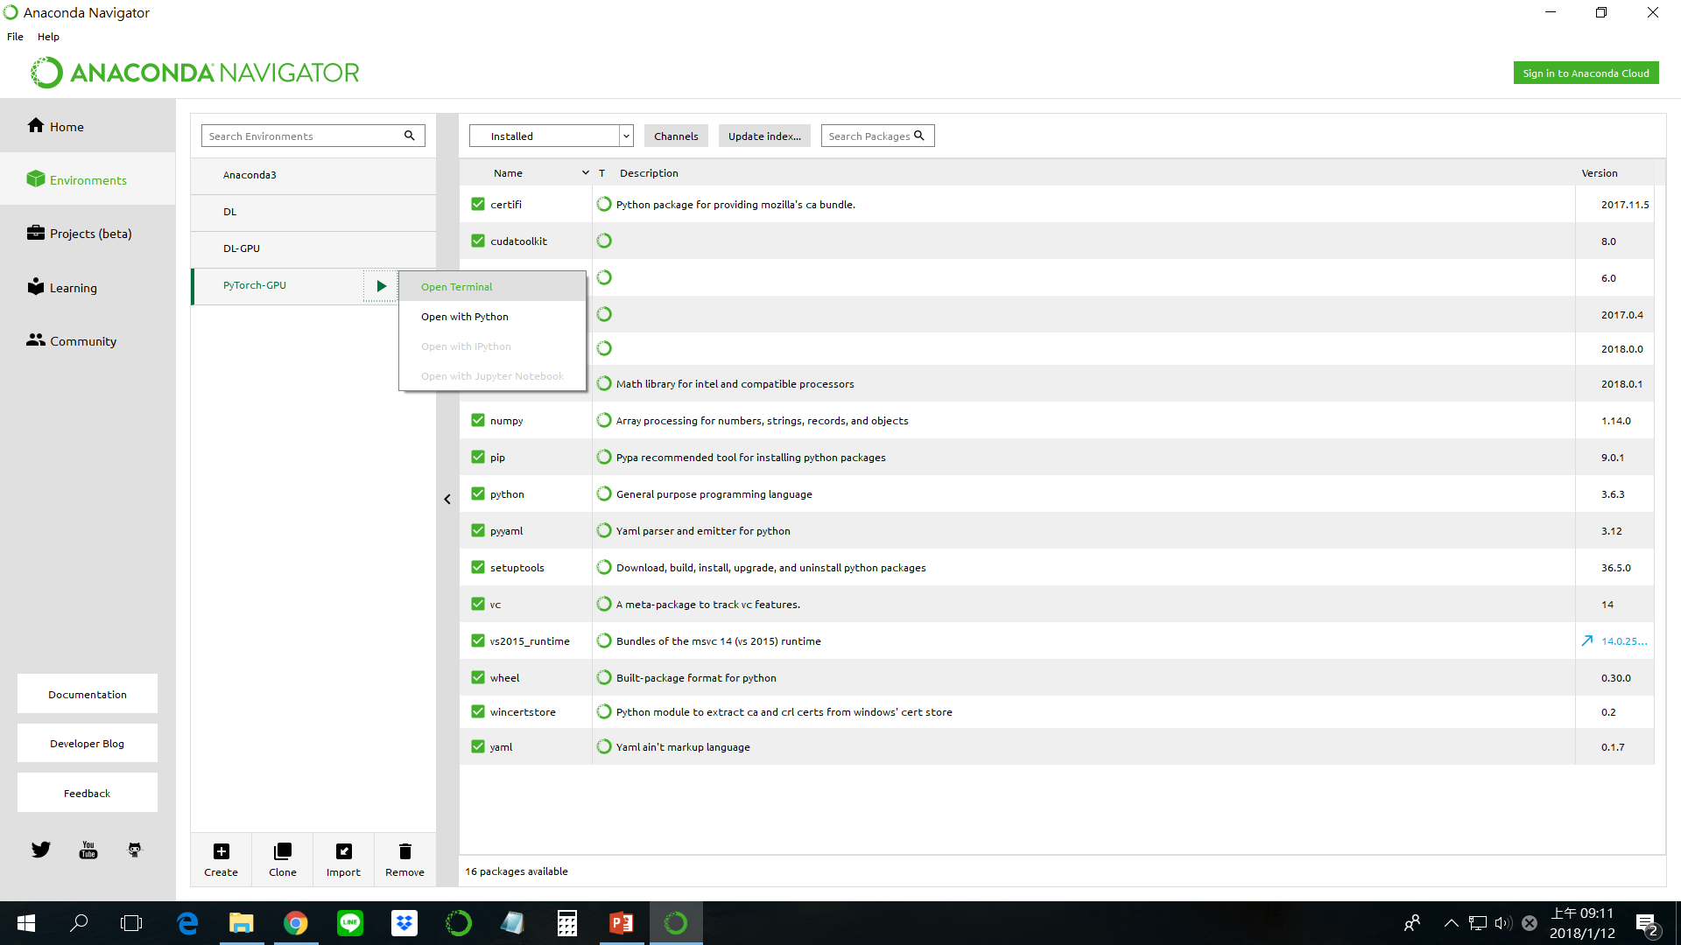
Open cmd line window in PyTorch-GPU environment

Slide 23
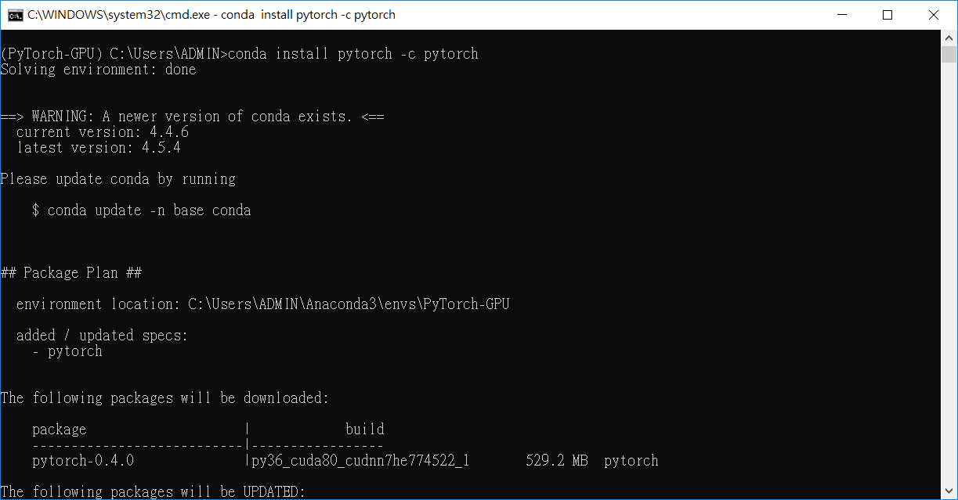
conda install pytorch -c pytorch

Slide 24
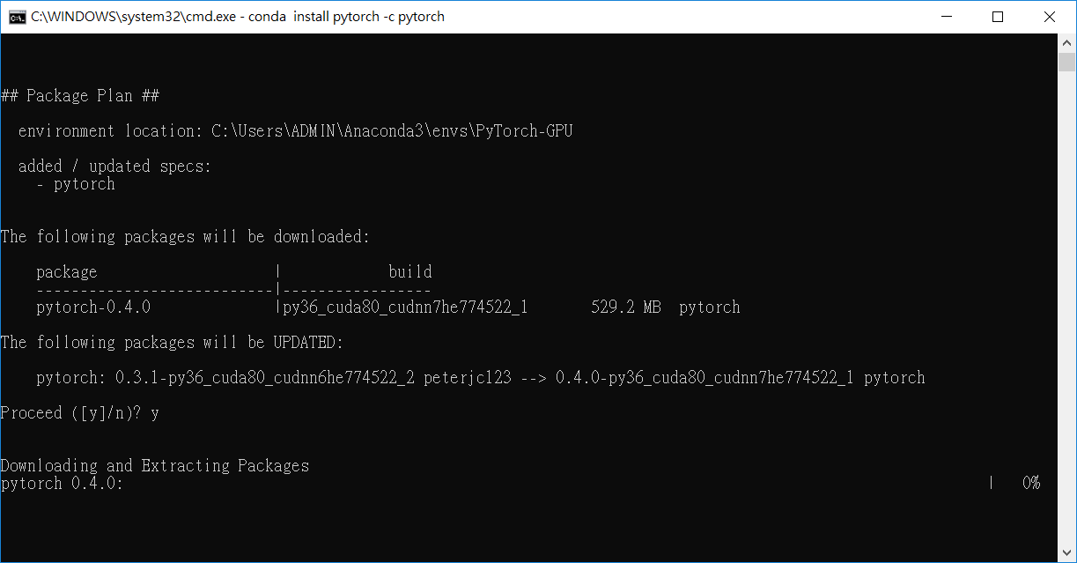

Slide 25
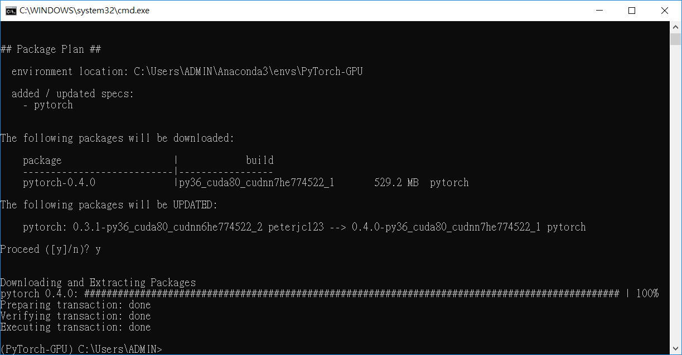

Slide 26
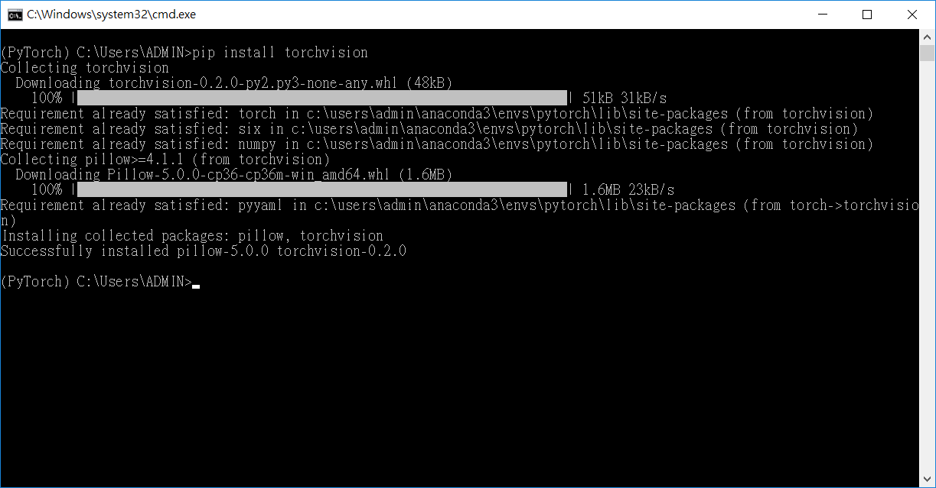
pip3 install torchvision

Slide 27
5. Install Jupyter notebook in this virtual environment

Slide 28
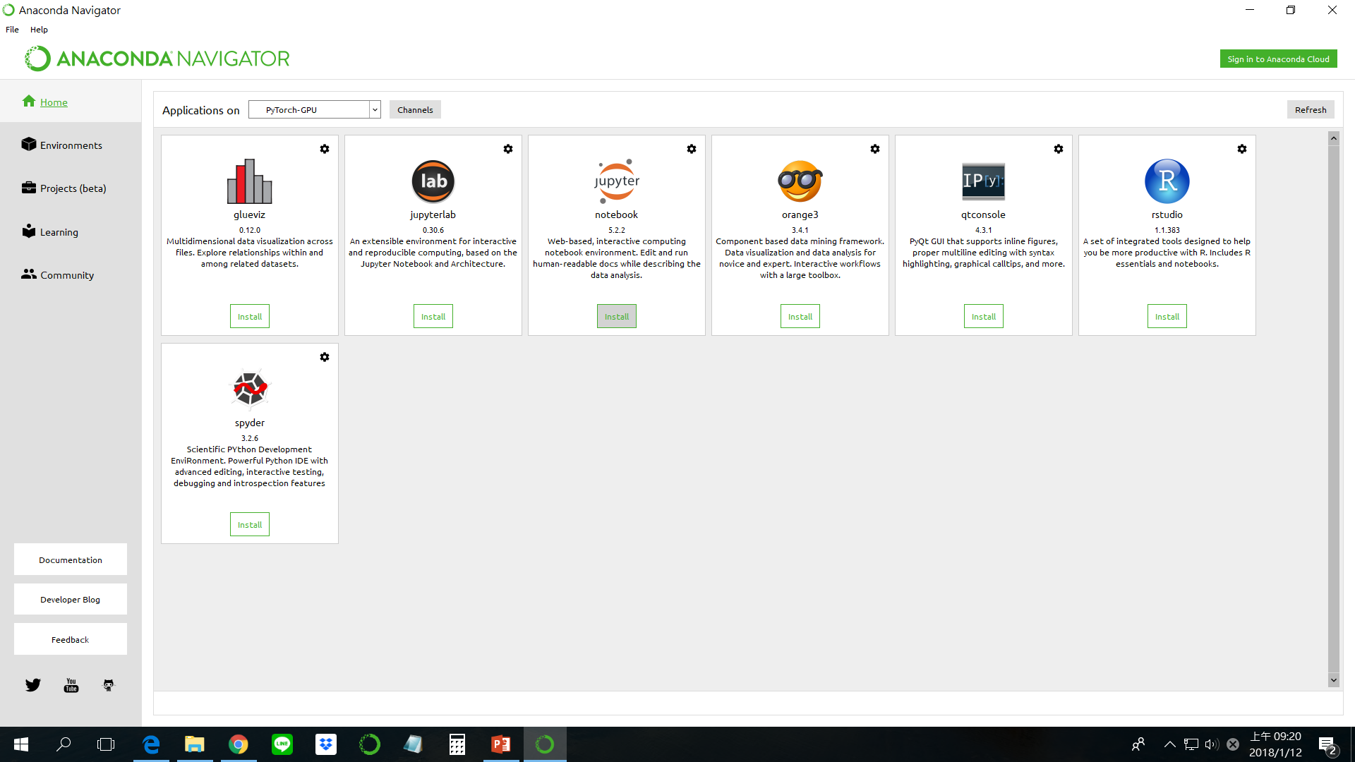
Install jupyter notebook in PyTorch-GPU environment

Slide 29
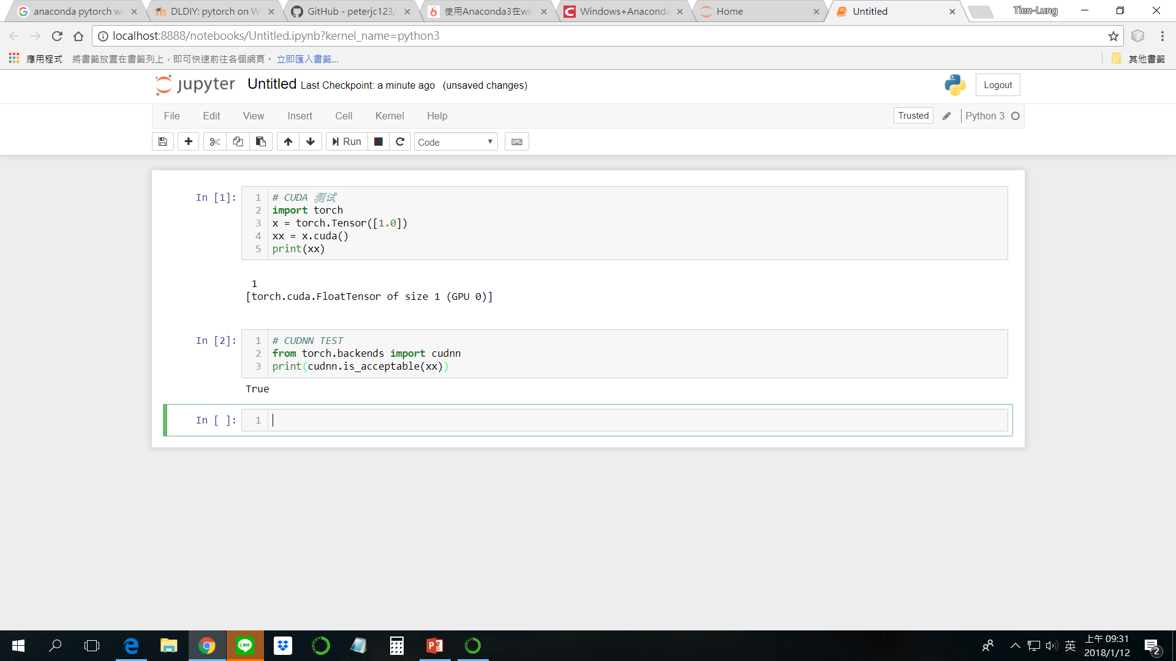
# CUDA 测试
import torch
x = torch.Tensor([1.0])
xx = x.cuda()
print(xx)
# CUDNN TEST
from torch.backends import cudnn
print(cudnn.is_acceptable(xx))
Shift + Enter to run each cell

Slide 30
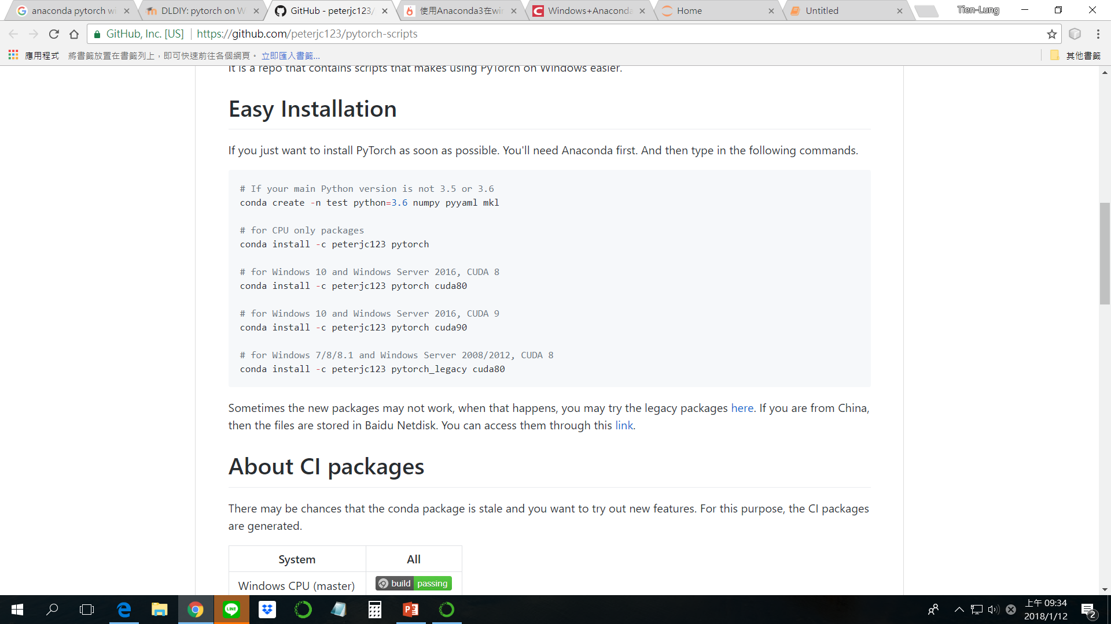
Ref: https://github.com/peterjc123/pytorch-scripts

